Slide 1
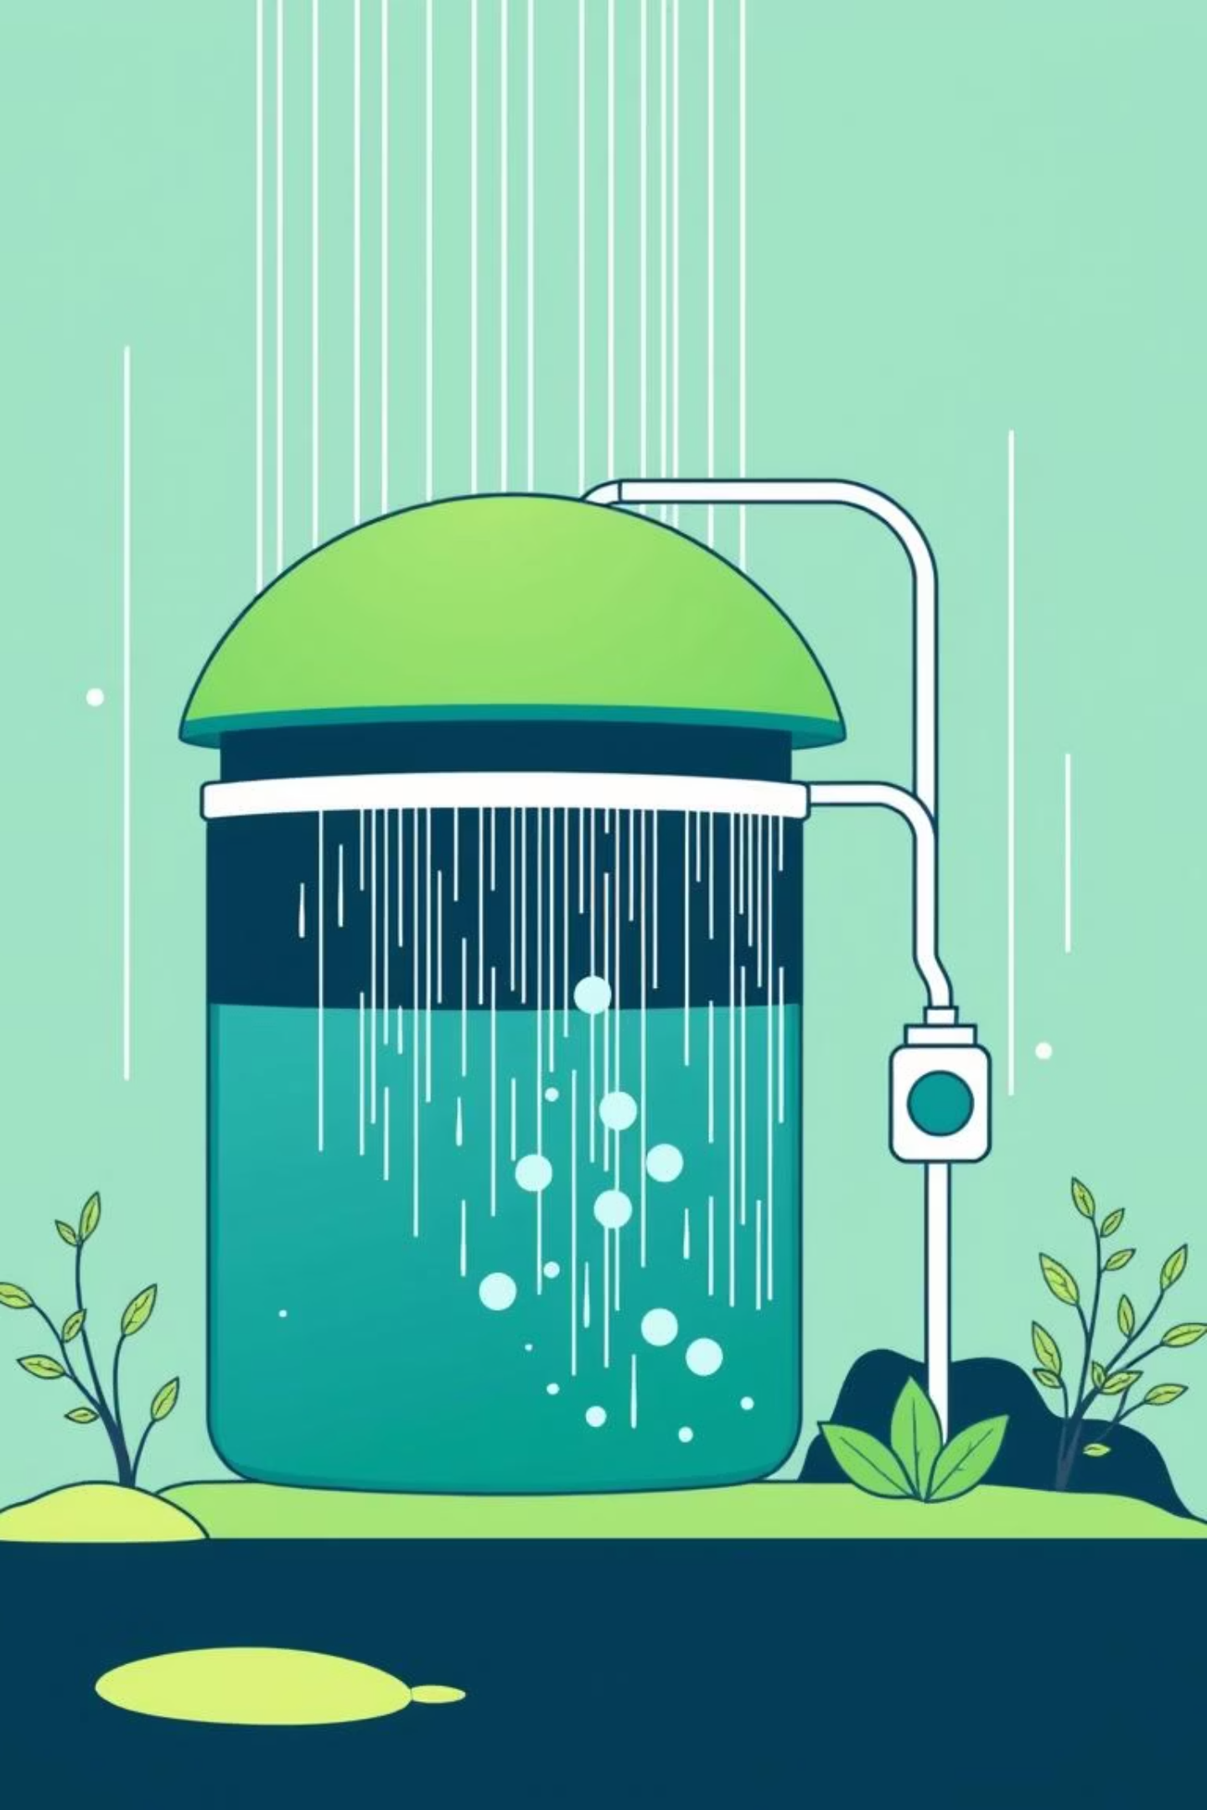
Visual Simulation of Rainwater Harvesting Systems
Computer Graphics
By 404 Found

Slide 2

Introduction to Our Project
Our project delves into the fascinating world of computer graphics to model and simulate a crucial environmental system: rainwater harvesting.
Area of Focus
Interactive 2D/pseudo 3D simulation, Line Drawing algorithm and interactive visualization
Importance
Educating on Rainwater Harvesting System and use with interactive design.

Slide 3
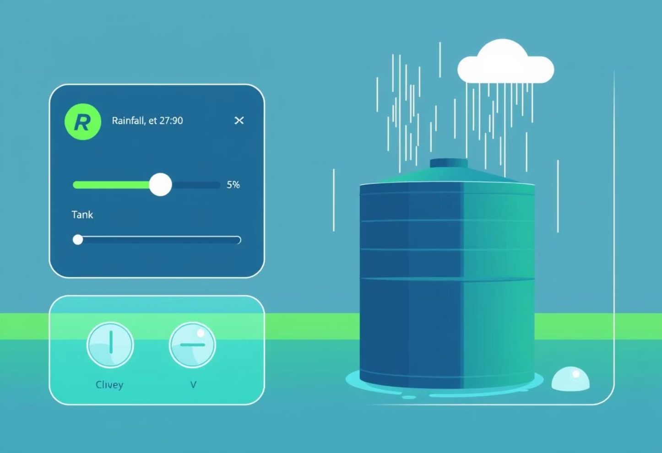
Creative Vision: Bringing Systems to Life
The Art of Interactive Visualization
We embrace the creative challenge of transforming real life systems into interactive art.
Computer graphics allows us to translate abstract concepts into engaging, dynamic visual experiences.
Storytelling Through Design
Our project explores the artistic potential of combining technology with environmental aspect.

Slide 4
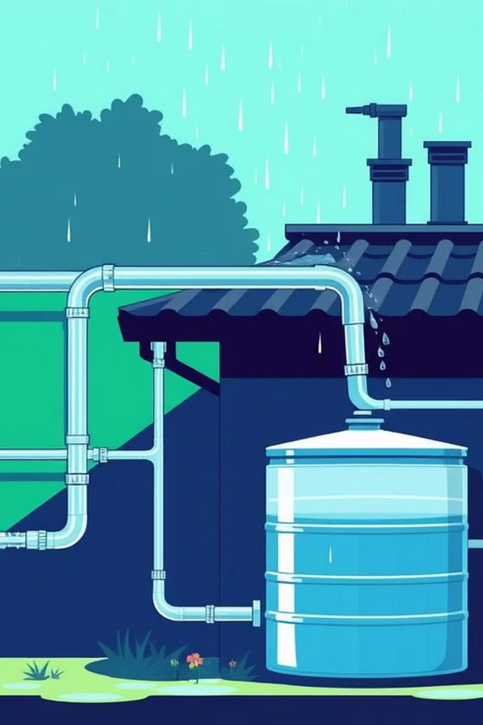
Project Objectives
What we aim to achieve:
1
Design a graphical application
To simulate rainwater and water collection.
2
Apply computer graphics concepts
Bringing realistic simulation to life.
3
Develop interactive features
Allowing users to manipulate variables and observe outcomes.

Slide 5
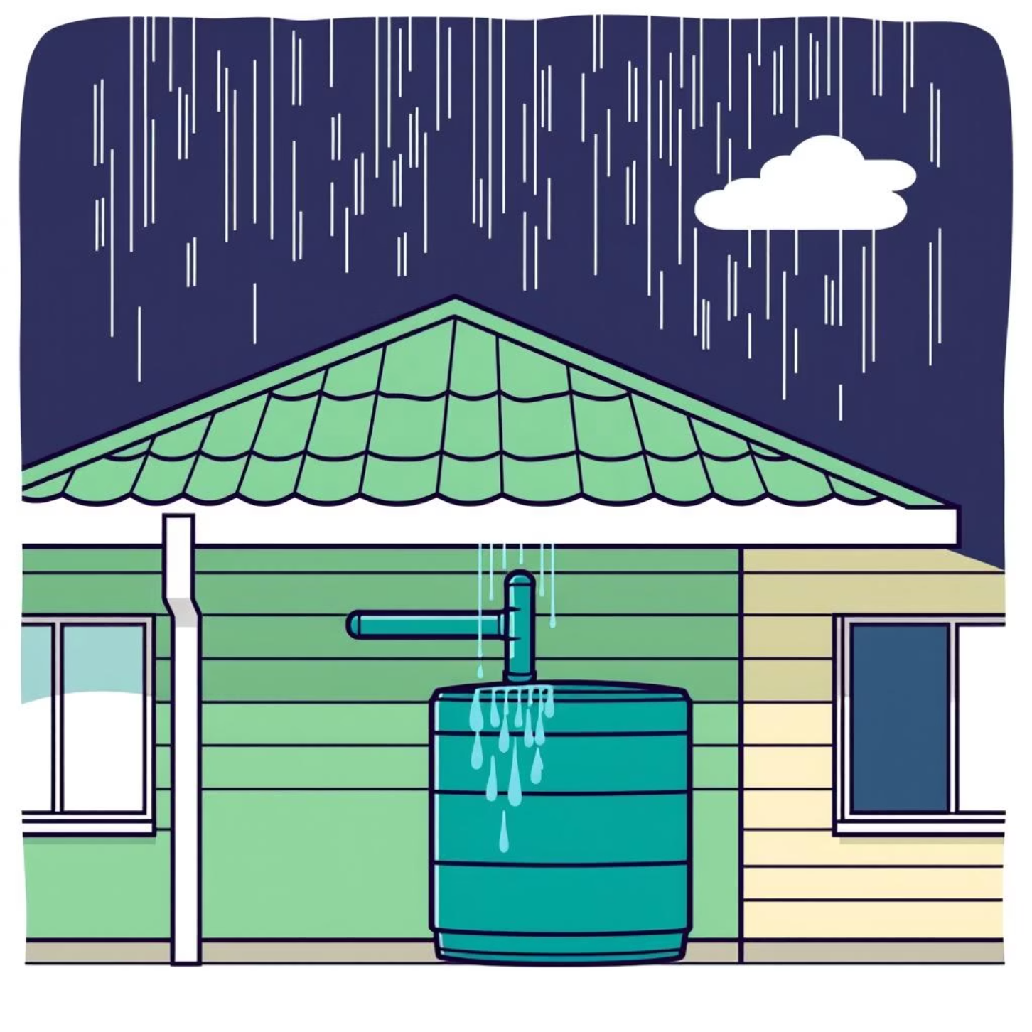
Project Overview: How it Works
System Simulation
The application visually models a rainwater harvesting system.
Users interact to simulate rainfall, collection via gutters, storage in tanks, and distribution for various uses.
Interactive Elements
Adjust rainfall intensity.
Modify tank capacity.

Slide 6





Key Computer Graphics Concepts Applied
This project leverages a multitude of computer graphics techniques to bring the rainwater harvesting system to life.
3D Graphics
Utilising a combination of 2D for interface elements and 3D for environmental models and water bodies.
Drawing Algorithms
Implementing algorithms for rendering pipes, tanks, and water flow lines.
(e.g., Bresenham's for lines, Midpoint Circle Algorithm).
Transformations
Translate, rotate, and scale elements for dynamic views.
Animation & Rendering
Creating dynamic water flow, rainfall, and tank level change.
Interaction Handling
Enabling user interaction with various elements, allowing for adjustments within the simulation.

Slide 7
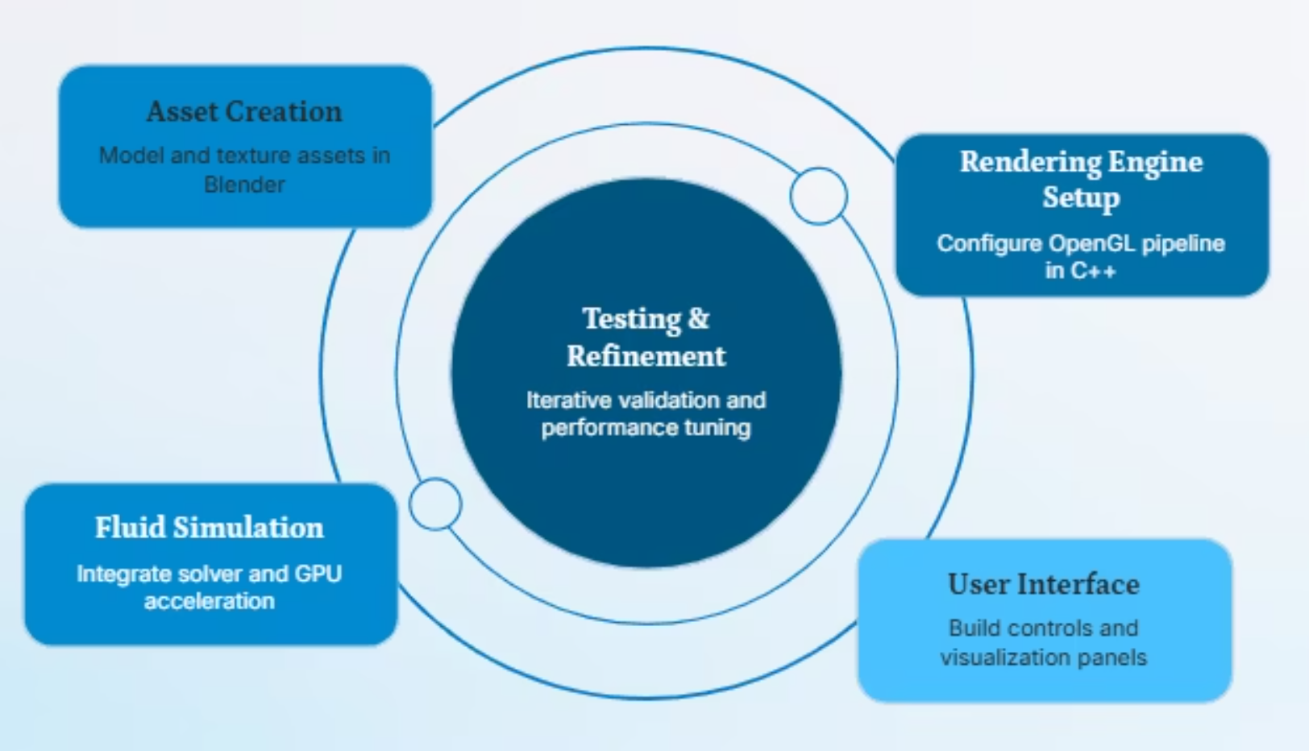
Methodology & System Design
Tools & Technologies
Programming Language: Python for core logic.
Graphics Library: OpenGL and Pygames
IDE: Visual Studio
Workflow
Asset Creation → Rendering Image → Simulation logic → User interface → Fluid Simulation

Slide 8
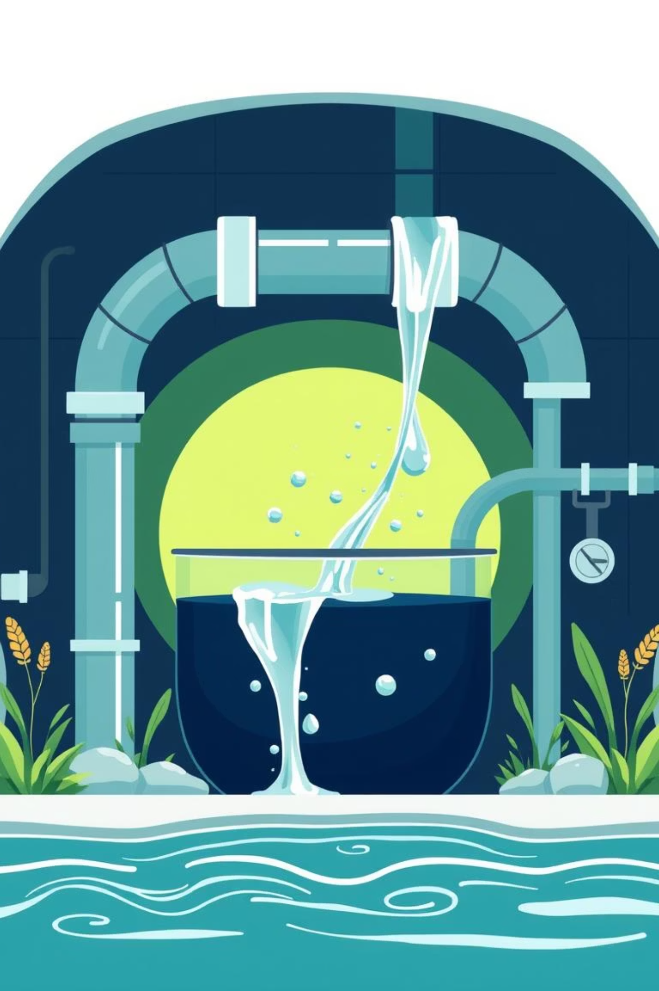
Features & Functionalities
1
Dynamic Rain Simulation
Adjustable rainfall intensity.
2
Real-time Water Flow Visualization
Animated water paths from roof to tank.
3
Interactive Tank Management
Monitor water levels, capacity, and overflow.
4
Dynamic Scenarios
Change in the background according to intensity of rain.

Slide 9

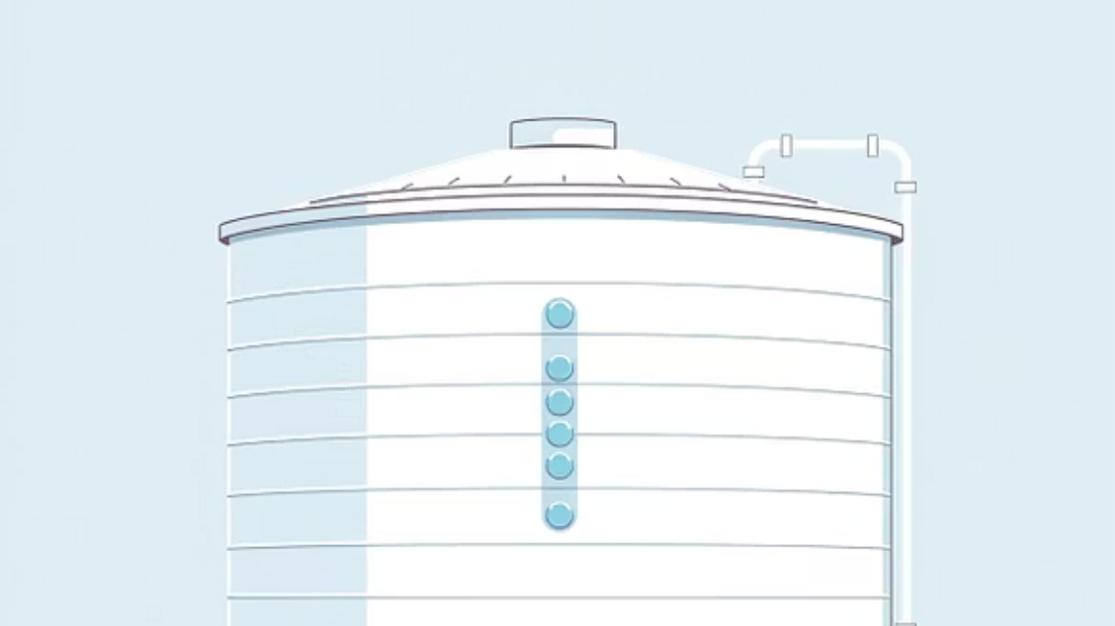
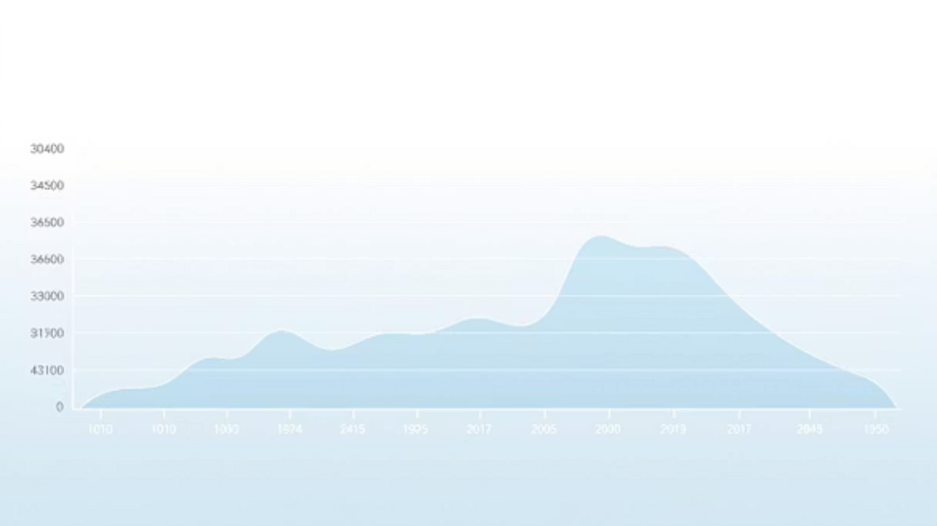

Expected Output & Results
Our final output will be an interactive 2D/3D simulation showcasing the full functionality of a rainwater harvesting system, complete with adjustable parameters and clear visual feedback.

Slide 10
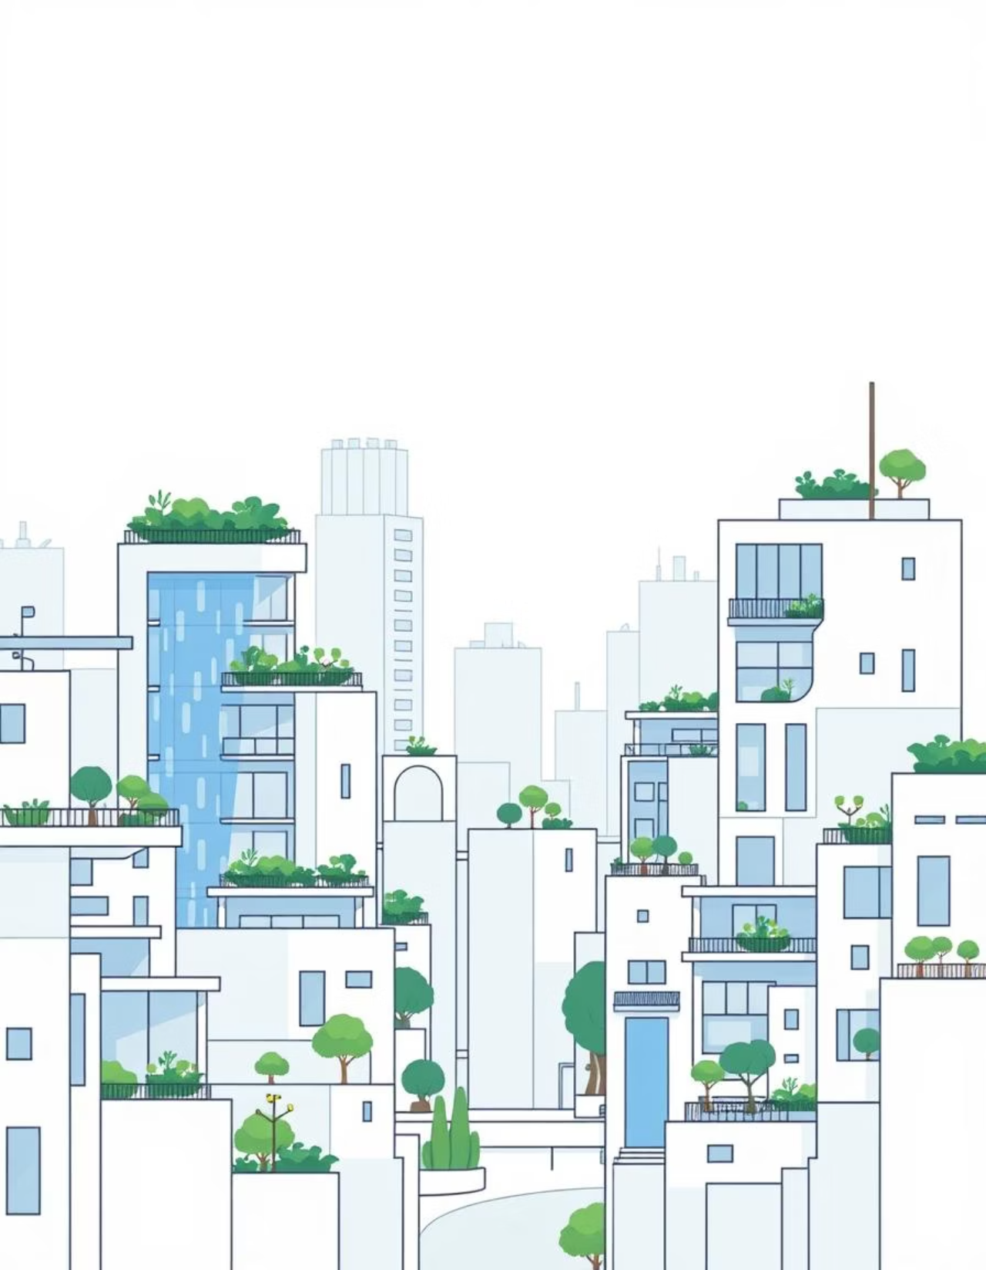
Conclusion:
Project Summary
A dynamic, interactive simulation of rainwater harvesting, blending CG principles with environmental education.
Feasibility
Achievable within the project timeline, leveraging established graphics libraries and development practices.
CG Relevance
Excellent platform for applying 2D/3D modelling, animation, rendering, and interaction techniques.
This project not only demonstrates advanced computer graphics skills but also contributes to understanding critical sustainability practices.

